Slide 1
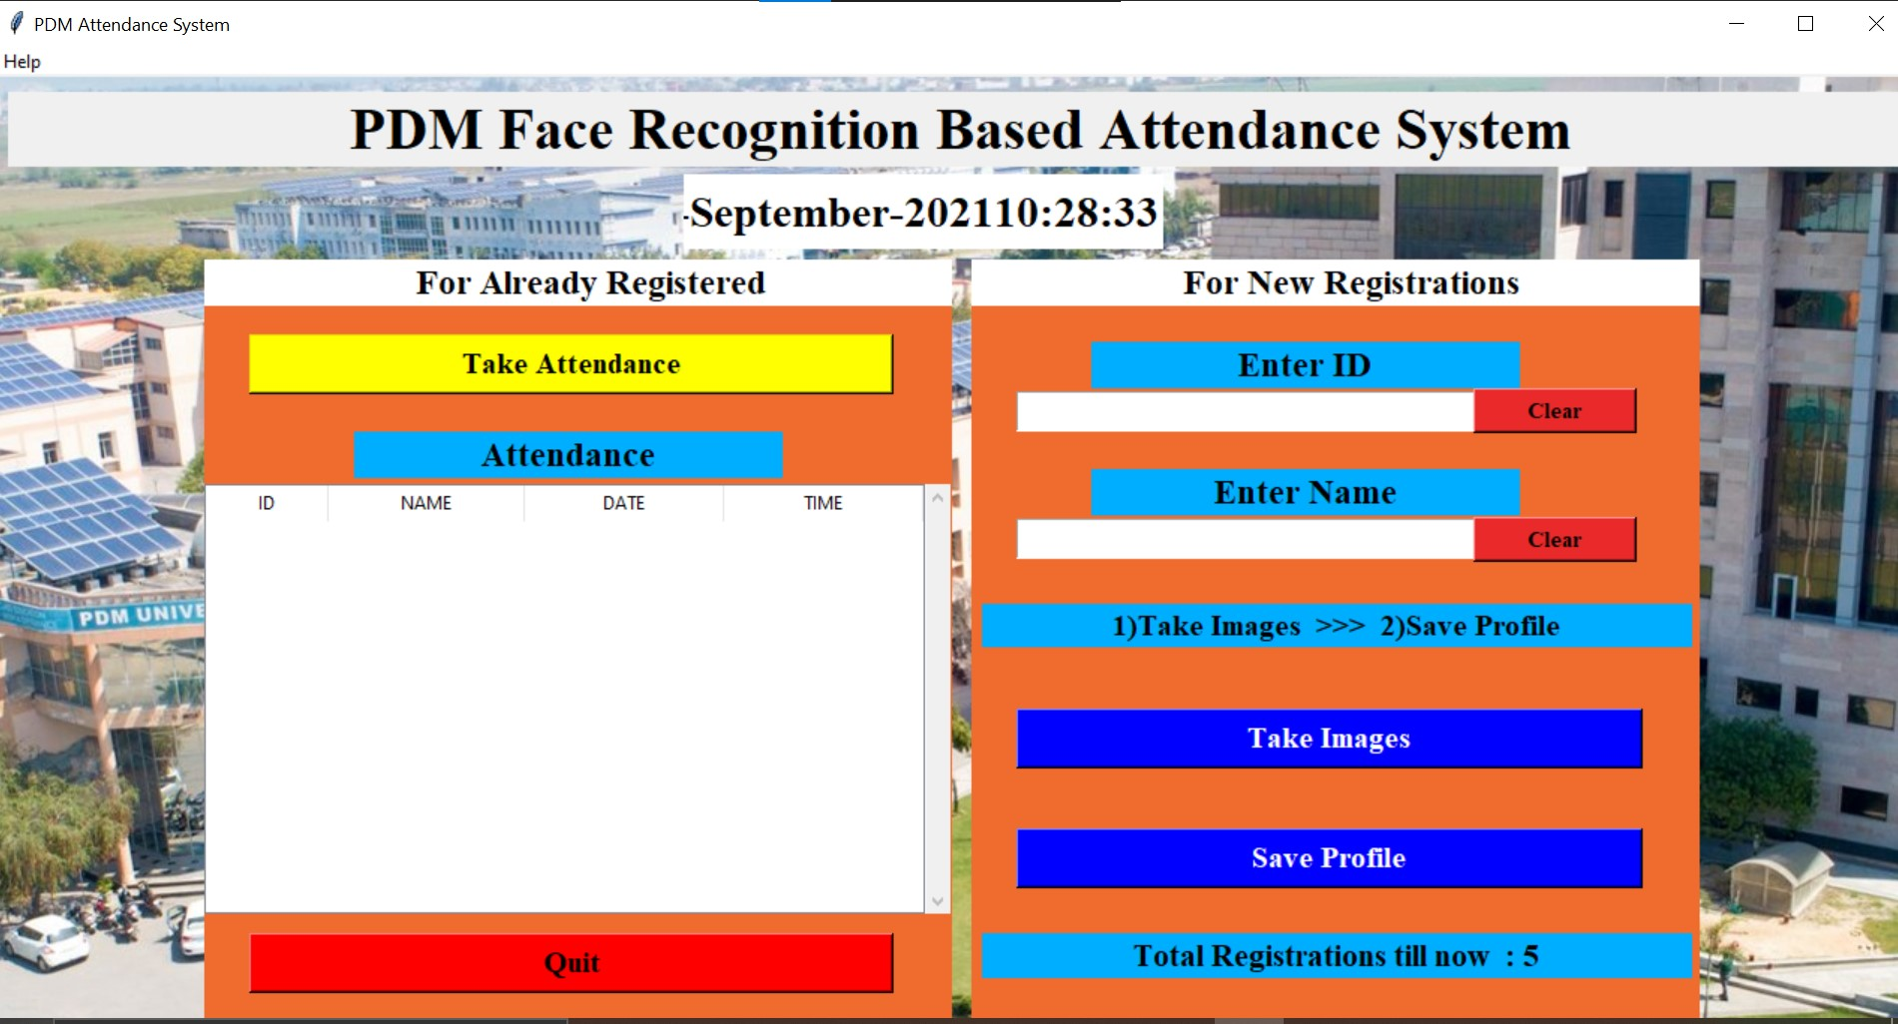
PDM FACE RECOGNITION BASED ATTENDANCE SYSTEM

Slide 2

Presentation on
PDM Real Time Attendance System
Of
BACHELOR OF TECHNOLOGY
IN
COMPUTER SCIENCE AND ENGINEERING
by
Ravi Kumar(A40318039)
Kavita Singh(A40318083)
Abhinav Kumar(A40318046)
Muskan Chauhan(A40318075)
Shalu Sharma(A40318054)
Under the guidance of
Prof. Mr. Tarun Dalal
Department of Computer Science & Engineering
Prabhu Dayal Memorial University, Sarai Aurangabad

Slide 3
1.
INTRODUCTION
Let’s start with the first set of slides

Slide 4
An automated system for human face recognition in a real time background for an organization to mark the attendance of their employees/students is a real world solution which comes with day to day activities of handling employees. Using the face characteristics as biometric, the face recognition system can be implemented. In the traditional attendance system , their presence or absence is marked manually. However, these traditional techniques are time consuming.

Slide 5
PURPOSE, SCOPE AND OBJECTIVE
Purpose
Facial recognition software affords employers a means of tracking their employees/students' attendance while eliminating human error
Future Scope
A mail which contains the information about absent as well as attendance percentage is mailed to the respective parents instead of messages using face recognition based attendance management system. Process of taking attendance is done module by module, it is possible to update attendance in one click or touch instead. Parents can also get the information about the internal assessment marks through messages if their children.
Objective
To develop a software that will facilitate attendance management by detection and recognition of students faces and record the attendance live using webcam
The system would be able to match detected students faces cropped from an image to those on a database on the system

Slide 6
FEATURES
Reduce the risk of fraud or “proxy” clocking in.
Detects and Track Faces in real time.
Mark the attendance in excel sheet automatically .

Slide 7



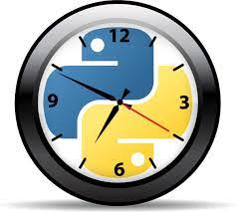


SOFTWARE DESCRIPTION
Front End
Tkinter
Python DateUtil
Python Time
Back End
OpenCV CSV
NumPy
Pandas

Slide 8
TECHNICAL REQUIREMENTS
Software Requirements
Python == 3.6.7
tkinter==1.3.3, os-sys==2.1.4 , six==1.16.0(Front End)
numpy == 1.21.2 , opencv-python==4.5.3.56 , pa https://pandas.pydata.org/ndas==1.3.2 , pillows==8.3.2 , python-datautil==2.8.2 (Back End)
Microsoft Windows , Linux , Mac Internet Explorer (5.0 and above) or Mozilla Firefox (6.0 and above)
VSCODE text editor , A Bash terminal / command prompt.
Hardware Requirements
Intel core 2 (minimum spec)
Ram :- 2 GB
Computer Memory :- 128 GB
Intel HD graphics (minimum version 15.40.46.5144)

Slide 9
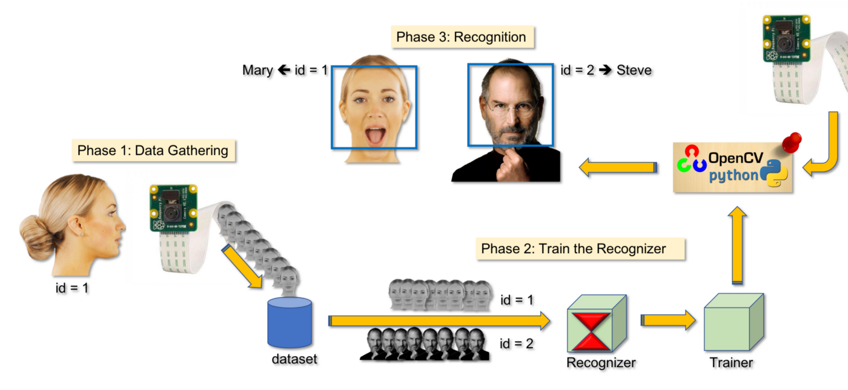
WORKING

Slide 10
GOAL OF THE PROJECT
● Verification - a one-to-one matching of an unknown face alongside a claim of identity, to ascertain the face of the individual claiming to be the one on the image.
● Identification - which is also a one-to-one matching, given an input image of a face for an individual (unknown), to determine their identity by comparing the image against a database of images with known individuals.
● To help the lecturers, improve, and organize the process of tracking and managing student attendance.
● Provides a valuable attentive service for both teachers and students.
● Reduce manual process errors by providing automated and reliable attendance systems.
● Produce monthly reports for lecturers.
● Flexibility, lectures capability of editing attendance records.
● Reducing time losses as it is a very valuable resource.

Slide 11
WORK DIVISION WITH RESPECT TO TIME
Sr. no. | Task | Date
1. | Installations of Pycharm ((python environment) along with OpenCV libraries | 2 Sept
2. | Conduct a literature survey to identify the algorithms suitable for developing our model | 8 Sept
3. | Developing Design and Architecture of our model, by resource implementation and initial prototyping | 27 Sept
4. | Implementing necessary changes with given feedback to counter underlying problems and tackle necessities | 10 Oct
5. | Review and Evaluation of our model with full-scale testing and corrections | 19 Oct
6. | System testing to improve the features | 5 Nov
7. | Complete documentation of the project with details in the Project Report | 10 Nov

Slide 12
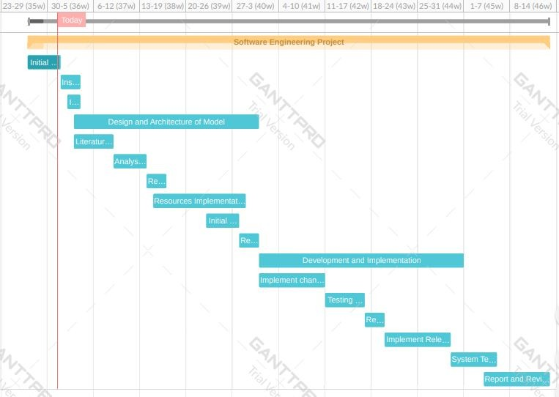
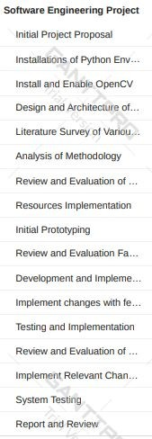
GANTT CHART

Slide 13
ADVANTAGES
The targeted groups of the attendance monitoring system are the students and staff of an educational institution.
Users should be able to register through their already existing accounts.
The user’s face should be sensed and captured by the camera
The database of the attendance management system can hold an individual’s information.
The detected face’s data should be matched with the database
The facial recognition process can only be done for one person at a time.

Slide 14
IMPROVEMENTS
Can improve security by adding administrator login.
Can use Neural Network for high accuracy.
Can be used in a big factory or employee attendance.
Can build on a fully web-based system.

Slide 15
THANK YOU

